Slide 1

Critically Evaluate the following
Y7 Drive
Regeneration
Information Posters

Slide 2
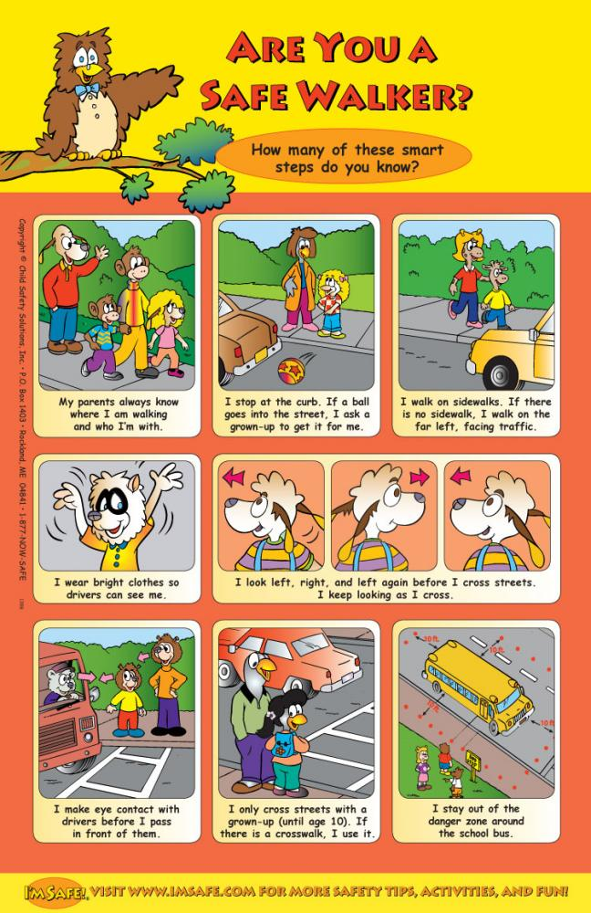


Slide 3


Slide 4


